Slide 1
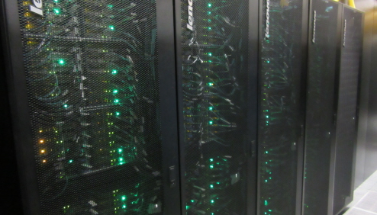
GEOGM0054 Introduction to Scientific Computing
Welcome to
Week 1 – 28/09/2022 - Introduction
Image credit: bristol.ac.uk/news/2017/may/blue-crystal4.html

Slide 2


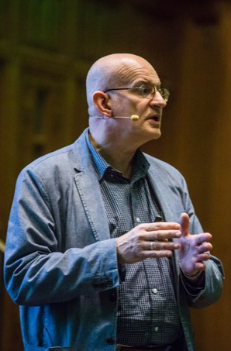

About us
Seb Steinig
sebastian.steinig@bristol.ac.uk
Office hours: Friday 11am-noon
Steph Cornford
s.l.cornford@bristol.ac.uk
Office hours: Monday 3-4pm
Tony Payne
a.j.payne@bristol.ac.uk
Office hours: Friday 10-11am
Claude de Rijke-Thomas
Demonstrator

Slide 3
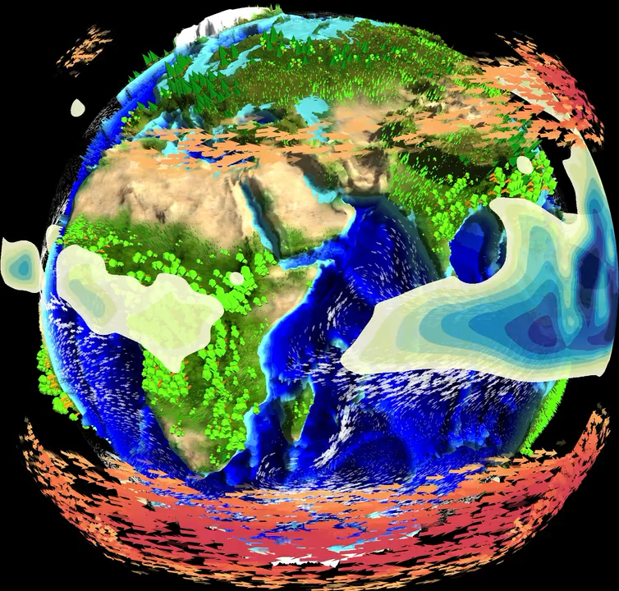
Seb Steinig
sebastian.steinig@bristol.ac.uk
@sebsteinig
Research on deep-time climate modelling (last 500 million years)
Climate change on geologic timescales and past warm periods
Trying to make climate model data more accessible
Using Python for model data processing and visualisation
climatearchive.org

Slide 4
Steph Cornford
Teaching on “Introduction to Scientific Computing” and unit convenor of “Environmental Modelling Applications” in TB2
Research on computational glaciology, including projections of the Antarctic Ice Sheet under future ocean warming
Developing techniques to represent processes on different length scales in adaptive mesh ice-sheet models
s.l.cornford@bristol.ac.uk

Slide 5
Tony Payne
3rd year undergraduate teaching on ‘Sea Level past, present and future’
Programme Director for MSc in Environmental Modelling and Data Analysis
Research using regional coupled ice sheet-ocean models and global climate models to project sea level
a.j.payne@bristol.ac.uk

Slide 6
Claude de Rijke-Thomas
MSci Physics
PhD Student in Physical Glaciology –estimates snow depths and properties over Arctic sea ice, using aircraft and satellite data (in Python^^)
Demonstrating for this module
Likes climbing (trees and rock), archery, kayaking, gaming and playing piano
claude.derijke-thomas@bristol.ac.uk

Slide 7
Outline for today
Overview of the course structure
Assessment
Why do we learn Python?
How do we learn Python?
Group exercise: algorithmic thinking
Your first line of code!

Slide 8
Learning outcomes
After completing this unit, you should be able to:
understand the complexity and the fundamentals of scientific computing
use scientific computing to solve Geographic Data Science problems
explain, understand, and employ analytical methods to analyse geospatial data sets
produce reproducible workflows
collaboratively develop and deploy scientific software with version control on Linux-based systems
develop high-performance computing strategies to do data science at scale

Slide 9
part 1 Python for Geographic Data Science / Seb Steinig
Week 1 (Wed, 28 September):
Lecture 1: Introduction and unit overview
Week 2 (Wed, 5 October):
Lecture 2: Introduction to Python
Week 3 (Wed, 12 October):
Lecture 3: Code structuring
Week 4 (Wed, 19 October):
Lecture 4: Numerical Python
Week 5 (Wed, 26 October):
Lecture 5: Analysing geospatial datasets
Week 6 (Wed, 2 November):
Lecture 6: Review of part 1 and introduction to assessment #1

Slide 10
part 2 High-performance computing / Tony Payne & Steph Cornford
exact order might change at a later stage
Week 7 (Wed, 9 November):
Lecture 7: Profiling, debugging and IDEs (Steph)
Week 8 (Wed, 16 November):
Lecture 8: Version control with git and GitHub (Steph)
Week 9 (Wed, 23 November):
Lecture 9: Linux introduction (Tony)
Week 10 (Wed, 30 November):
Lecture 10: Using high-performance computing (Tony)
Week 11 (Wed, 7 December):
Lecture 11: Parallelising code (Steph)
Week 12 (Wed, 14 December):
Lecture 12: Review of Part 2 and introduction to assessment #2

Slide 11
Assessment
Part 1 (Python for Geographic Data Science):
apply skills from first part of the unit to analyse a geospatial data set
notebook (Code+Figures) + 2000-word essay/practical report: 50%
introduced in week 6 with hand-in date in mid-November
Part 2 (High-performance computing):
version-controlled code development and debugging
written code + 2000-word essay/practical report: 50%
introduced in week 12 with hand-in date in mid-January
exact hand-in dates will be announced in upcoming lecture and on Blackboard

Slide 12
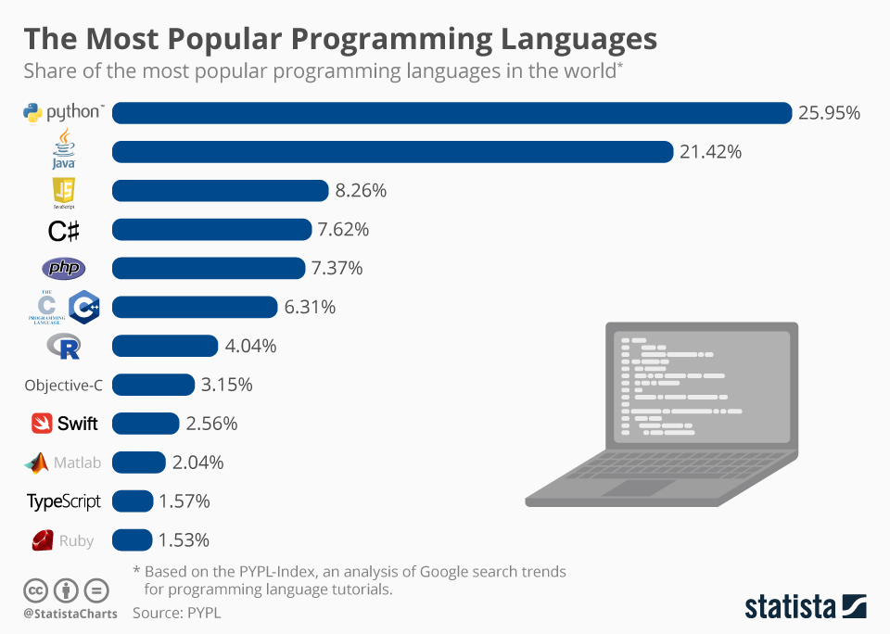
Why do we learn Python?
a programming language allows us to give a set of instructions to a computer
so which is the best programming language?
counter question: Which is the best human language?
it depends on the purpose, but Python is a very popular choice because:
general-purpose and open-source
high-level language
interpreted language
https://www.statista.com/chart/16567/popular-programming-languages/

Slide 13
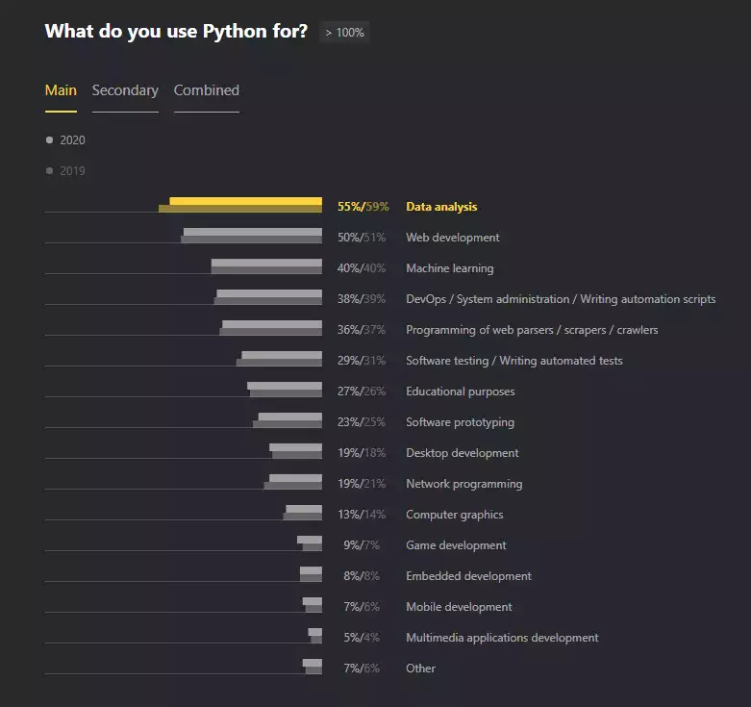
1. Python is general-purpose and open-source
https://www.jetbrains.com/lp/python-developers-survey-2020/

Slide 14
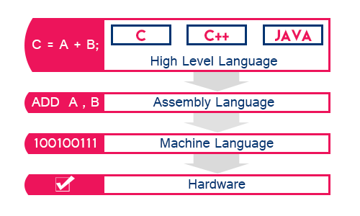
2. Python is a high-level Language
+
Python
http://www.btechsmartclass.com/c_programming/C-Computer-Languages.html

Slide 15
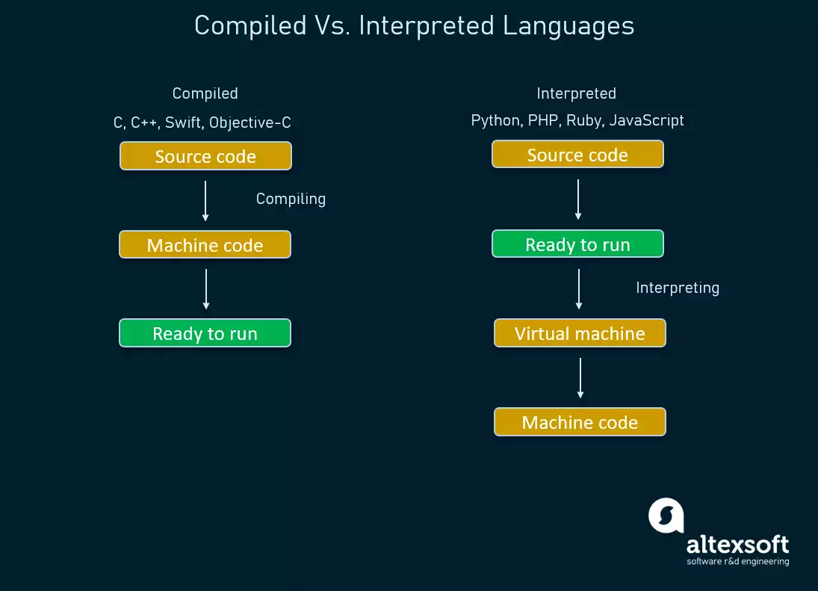
3. Python is an interpreted Language
https://www.altexsoft.com/blog/python-pros-and-cons/

Slide 16
Why do we learn Python?
1. general-purpose and open-source
flexible and widely used with a large and active community
de facto standard in data science and machine learning
2. high-level language
simplified syntax (i.e. language rules) make it easy to learn for beginners
high readability (e.g. no need to declare variable types = dynamic typing)
3. interpreted language
saves you additional compilation step -> rapid development cycle
code is interpreted/translated line-by-line -> easier to debug

Slide 17
How do we learn Python?
Three important steps : Practice, make mistakes, and practice more!
Joint Learning:
new exercises/workbook uploaded to Blackboard every Monday (under Learning Materials)
~two-hour computer-lab based lecture on Wednesdays at 9am in the Fry building in LG.21
introduction of new concepts by lecturer, but focus on solving exercises by writing your own code
work at your own speed and finish exercises during the rest of the week
you can bring your own laptop or work on the provided computers
Independent Learning:
technical unit, i.e. time you would normally put into a unit reading relevant text books and literature is spent doing homework/coding exercises
amazing, free online resources available; worth to try additional approach to learn coding
links to online courses, textbooks and YouTube videos will be added to Blackboard (under Resource lists)
maybe you already have small coding project in mind - now would be a great time to get started!
20 credit points unit -> ~200 hours to complete, made up of contact time, directed learning tasks, independent learning and assessment activity

Slide 18
Workspaces
Joint Learning:
~two-hour computer-lab based lecture on Wednesdays at 9am in the Fry building in LG.21
you can bring your own laptop or work on the provided computers
Independent Learning:
the Fry computer lab LG.21 is for teaching only
outside of lectures, you have access to identical PCs in:
Geography MSc study space (next to Fry computer lab, Math building)
Haggett Computer Lab (room 1.3N, Geography building)
Small Computer Room / Mini Hagget (room 1.4N, Geography building)
or continue to work on your own laptop (all software is freely available for Windows, Mac and Linux)

Slide 19
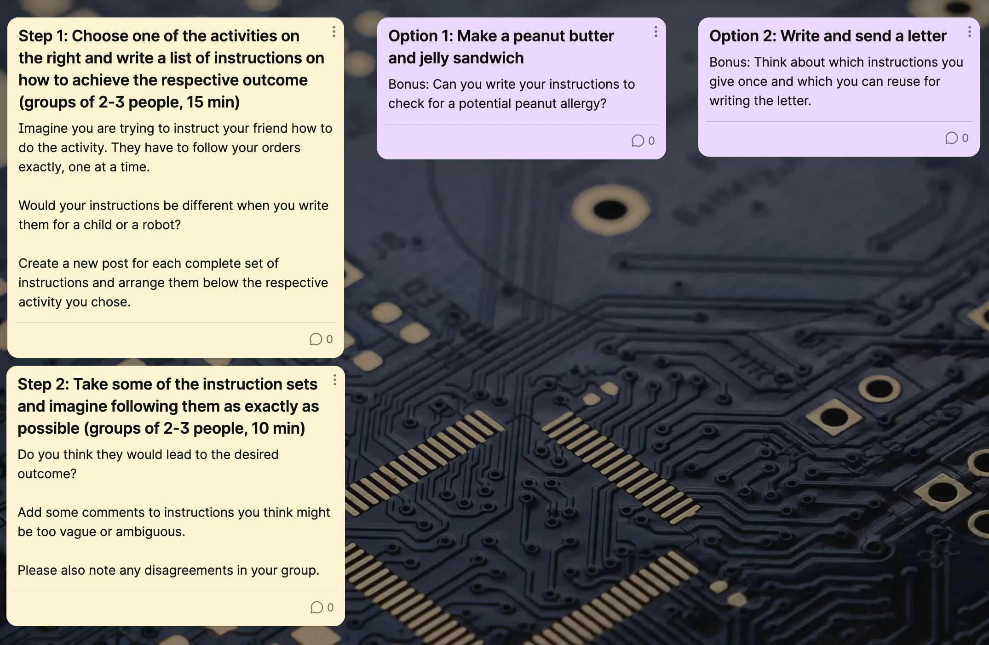

Group exercise: algorithmic thinking
before we start coding next week, let’s try to start thinking like a programmer!
Task: Write a set of instructions for a seemingly very easy activity.
use the Padlet link on the right to write your instructions (anonymous, no marking)
you can work and submit your instructions in groups of 2-3 people
https://uob.padlet.org/sebastiansteinig1/gztdm5ny99dfylxk
PW: GEOGM0054

Slide 20
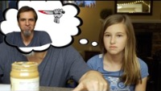
https://youtu.be/cDA3_5982h8

Slide 21
Getting started with Python!
we will be using a free tool called JupyterLab which provides you with a local editor in your web browser where you can write and run Python code
JupyterLab should be pre-installed on all UoB computers in the teaching lab, the MSc study space and the Geography Haggett Lab
you can start it by launching the Anaconda Navigator from the Windows start menu
if you want to work on your own laptop:
the easiest way to get access to JupyterLab is to install Anaconda 3, which is a piece of software which includes Python along with lots of other tools
it is freely available for Windows, Mac and Linux
go to https://www.anaconda.com/products/distribution and download the respective anaconda distribution for your operating system
open the Anaconda Navigator after the installation has finished

Slide 22
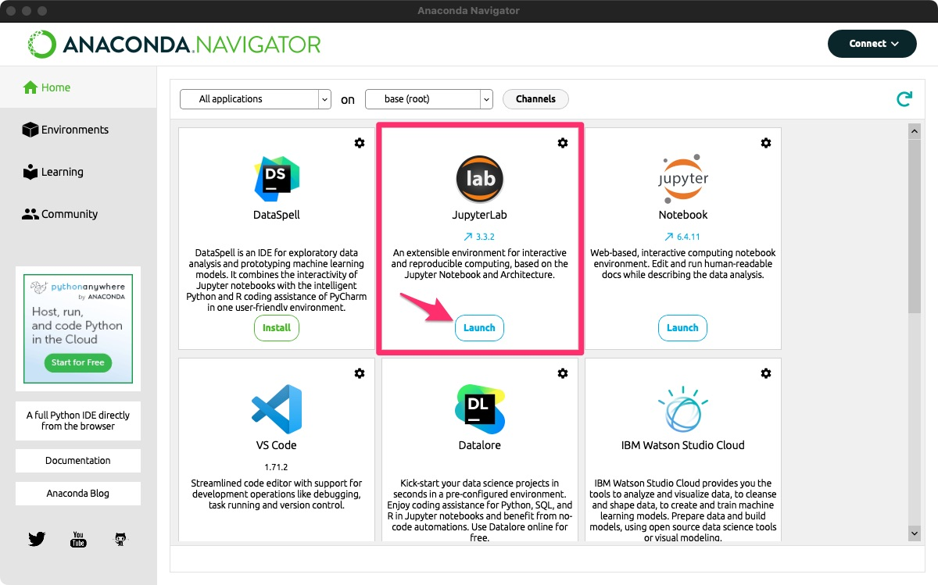
you should see the window below:

Slide 23
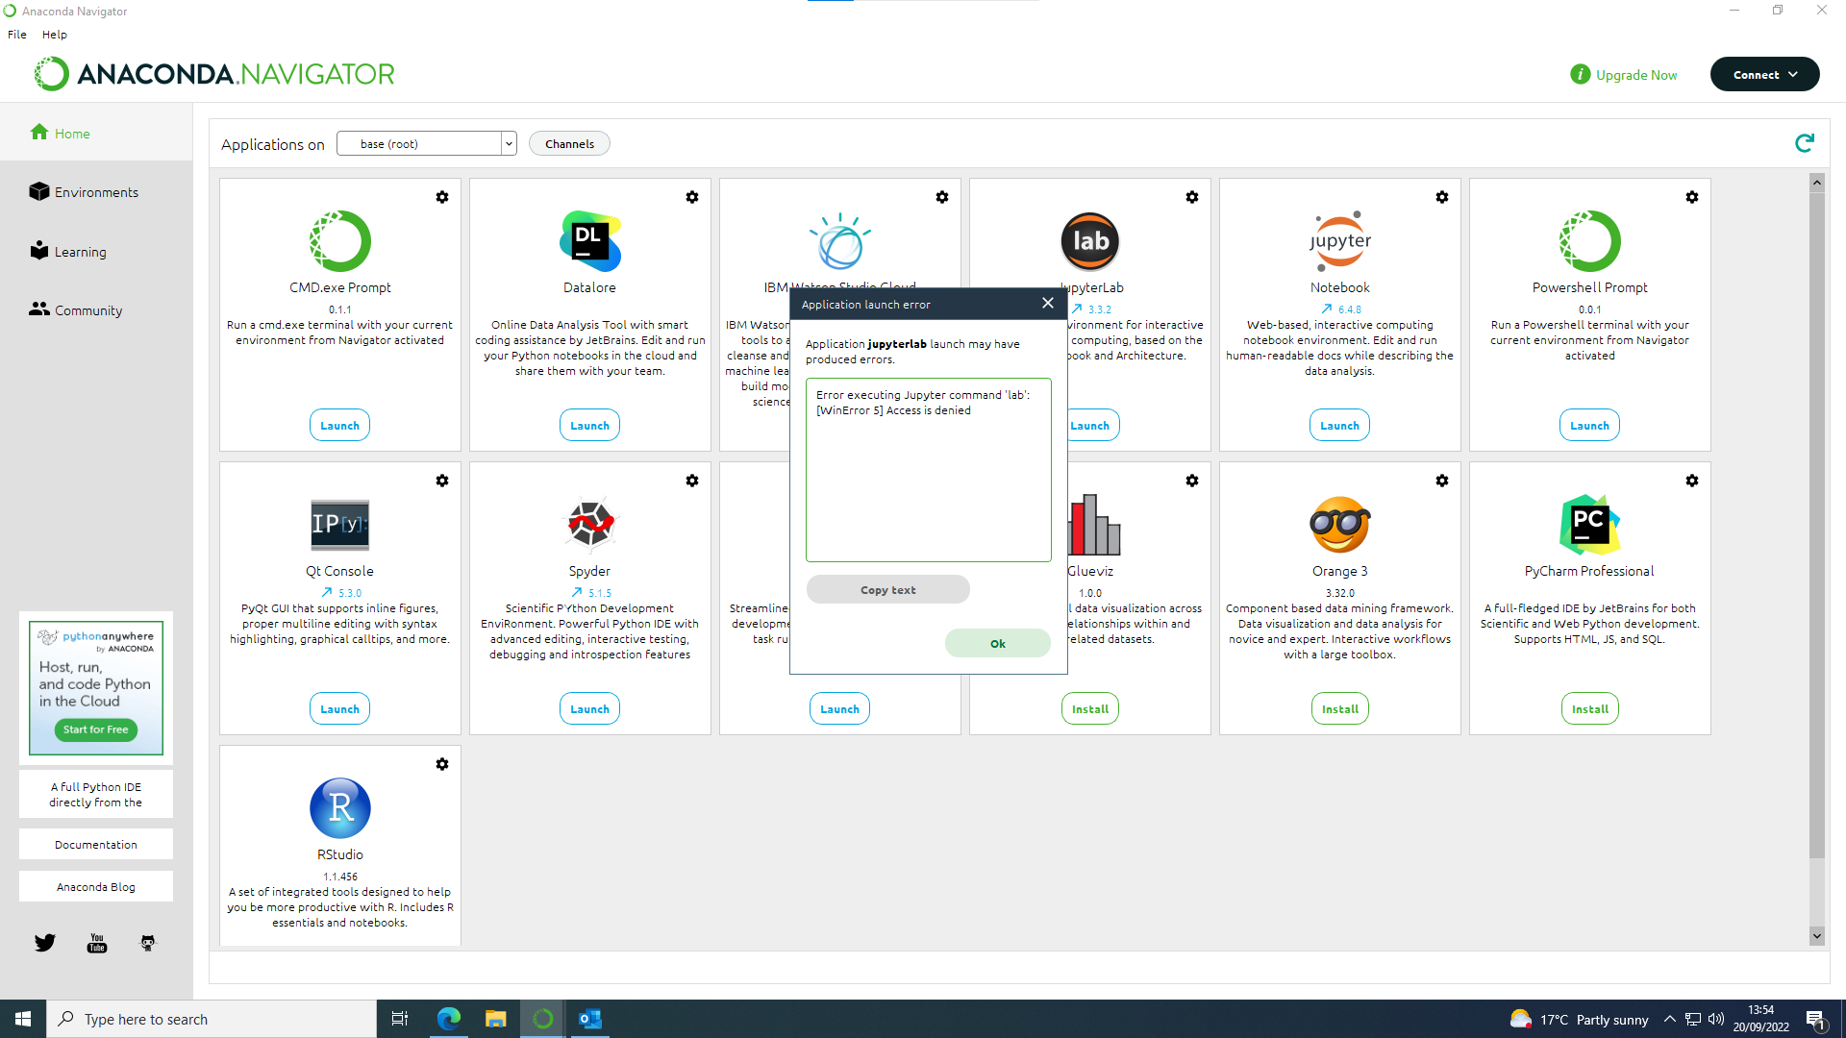
launching JupyterLab from an UoB computer might produce this error:
if this happens, just launch the ‘Notebook’ application instead and change the last part of the URL in your browser from ‘…/tree’ to ‘…/lab’

Slide 24
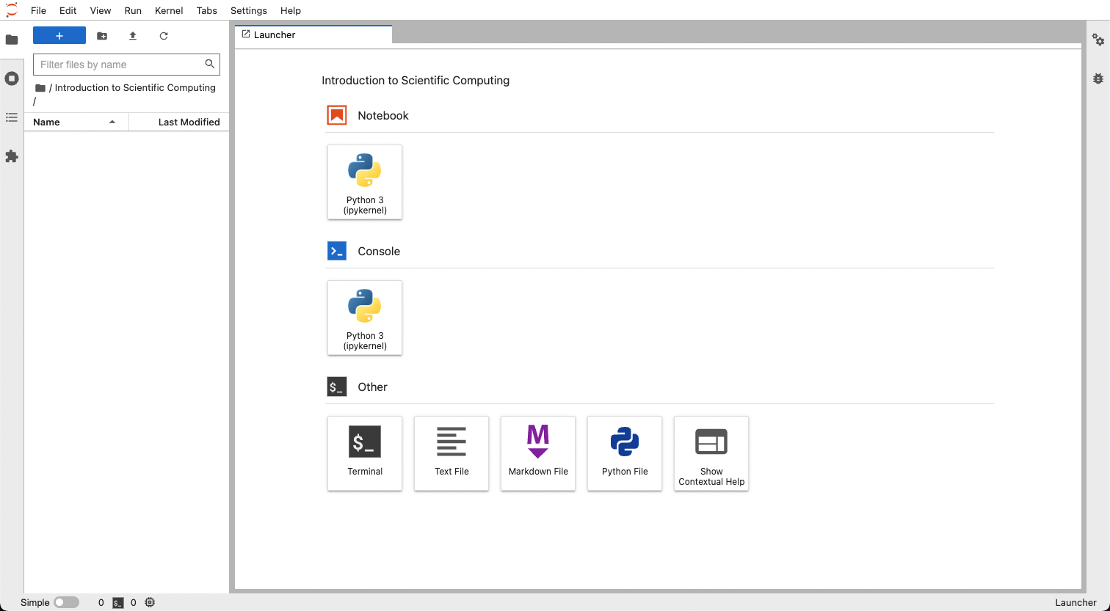
everybody should now get a browser window that looks similar to this:
let’s create a new work directory that you will use for the rest of the course
you can use the file browser on the left to navigate through your local files
ideally, you want to create this within your OneDrive folder for backup and syncing

Slide 25
we can now use the launcher to open our first notebook …

Slide 26
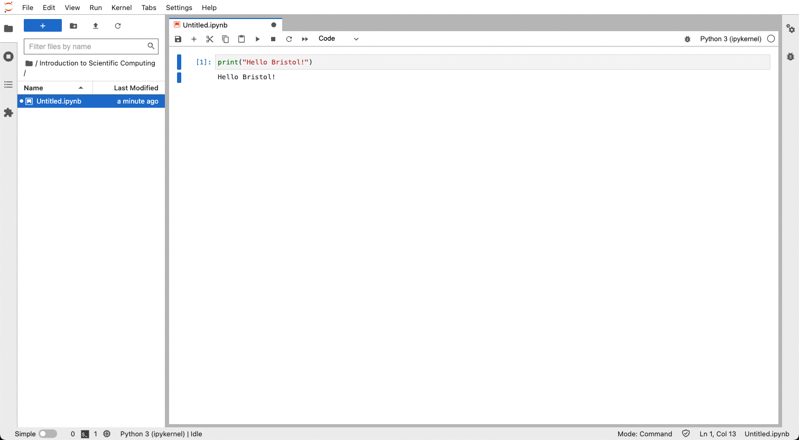
… and write our first line of code!
you can run the code by clicking the ’Play’ button in the toolbar or by pressing Shift+Enter
congratulations, you just used the Python programming language to give instructions to the computer!

